Slide 1
State
Storing and Changing State | Multiple State Variables | Object in State
Notes:
Welcome to our lecture on States in react. In this lecture we will go through storing and changing state, multiple state variables, and object in state. Let’s start the video lecture.

Slide 2

Storing and Changing State
A React component's state holds values that may change over time and affect the UI.
The useState() function initializes state and returns an array with the current state and a function to update it.
Array destructuring allows assigning these values: [greeting, setGreeting] = useState("Hello").
Notes:
Now, let’s discuss storing and changing state in React. A component's state holds values that can change over time, directly affecting the UI. The use State function initializes state and returns an array containing the current state and a function to update it. Using array restructuring, we assign these values for easy access. This approach allows dynamic updates, making components interactive and responsive.

Slide 3
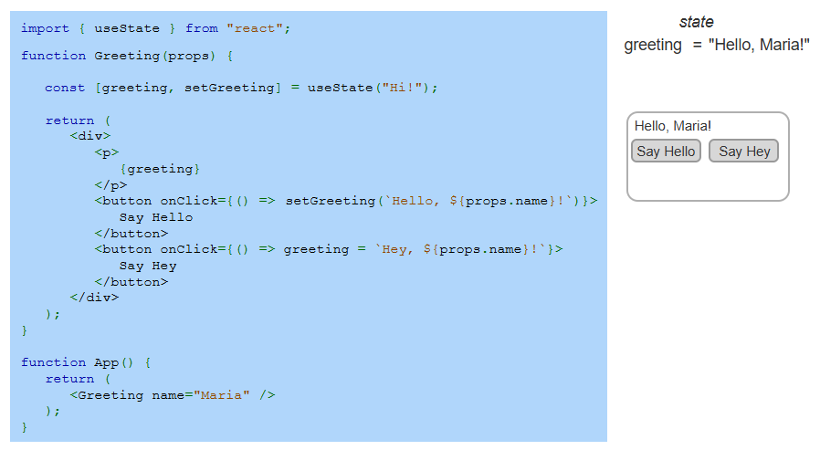
Example
Notes:
Up next, let’s explore this example of updating state in React. The Greeting component initializes its state with Hi using use State. When the Say Hello button is clicked, set Greeting updates the state with Hello and the user's name, causing a re-render. However, the Say Hey button incorrectly assigns a new value without set Greeting, so the UI does not update. Using set Greeting ensures React components respond properly to user interactions.

Slide 4
Multiple State Variables
React components often need multiple state variables to track different values.
useState() can be called multiple times to manage separate state values (e.g., title, rating, release year).
Updating state triggers a re-render, reflecting the new values in the UI.
Notes:
Now, let’s talk about using multiple state variables in React. Components often need to track different values separately, such as a title, rating, or release year. The use State function can be called multiple times to manage these values independently. Whenever a state variable updates, React triggers a re-render, ensuring the UI reflects the most recent changes dynamically.

Slide 5
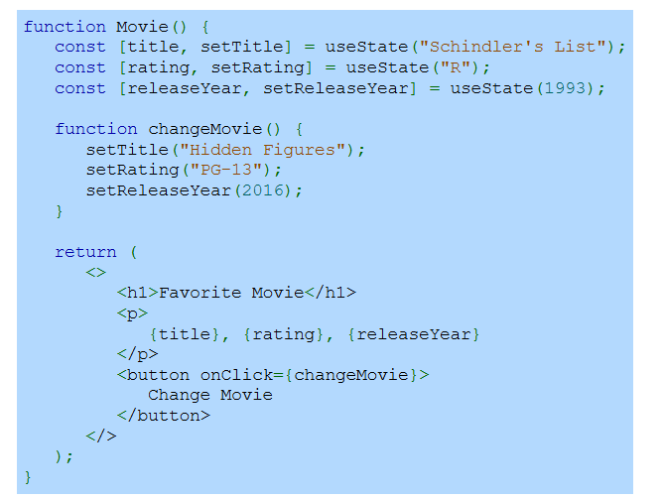
Example
Notes:
Let’s take a look at this example of multiple state variables. The Movie component tracks three separate pieces of state: title, rating, and release year. Clicking the Change Movie button triggers the change Movie function, updating all three values. Since each state variable is managed independently with use State, React efficiently re-renders only the necessary parts of the UI.

Slide 6
Object in State
Related state values can be grouped into a single object for better organization.
useState() can store an object, allowing multiple properties within one state variable.
When updating state, use the spread operator (...) to preserve existing properties.
Notes:
Now, let’s explore using objects in state. Instead of managing multiple state variables separately, related values can be grouped into a single object for better organization. The use State function can store an object, allowing multiple properties in one state variable. When updating state, the spread operator helps preserve existing properties, ensuring only specific values are changed.

Slide 7
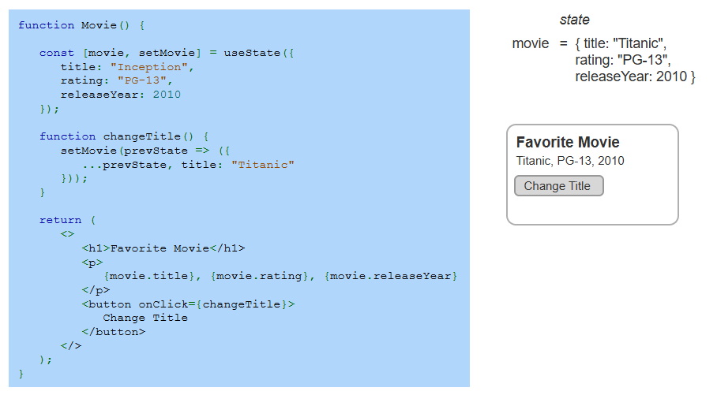
Example
Notes:
Let’s take a closer look at this example of using objects in state. The Movie component stores multiple properties in a single state object. The change Title function updates only the title while preserving other properties using the spread operator. Clicking the button updates the title to Titanic while keeping the rating and release year unchanged, ensuring efficient state management in React.

